Slide 1
Restaurant Exploration through the Lens of Reviews
Team 2: W. Ching, D. Goon, J. Ling, M. Speckmann, O. Shapira, L. Vidiella, X. Wang

Slide 2

Introduction
Online reviews are a big factor when one chooses where to eat. Yet, making a well-informed, quick decision can be a daunting task.
Star ratings won’t tell you specifically what was great/bad about a restaurant experience without a deep dive into reviews.
Star ratings can also vary across websites.
Through the use of web scraping, social media mining and text mining, we set out to analyze restaurant data and try and make a better informed decision.

Slide 3
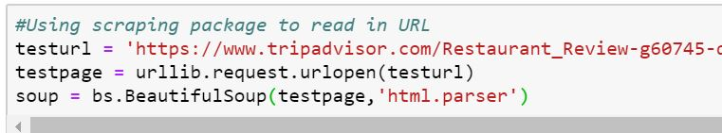
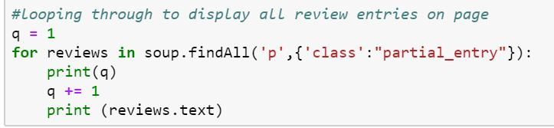
Gathering Data & Pre-Processing: Web Scraping
Used both Python and R packages to loop through a list of URLs and extract reviews for specific restaurants
Limitations:
Our code was only able to scrap the summary of each review which was the text displayed on the HTML of the website.
We were unable to loop through all the pages of the review website to retrieve every review written for a specific restaurant. The way that the website is structured means that all the different pages still share the same URL. This means that the library is not able to retrieve the html code of the other pages.

Slide 4
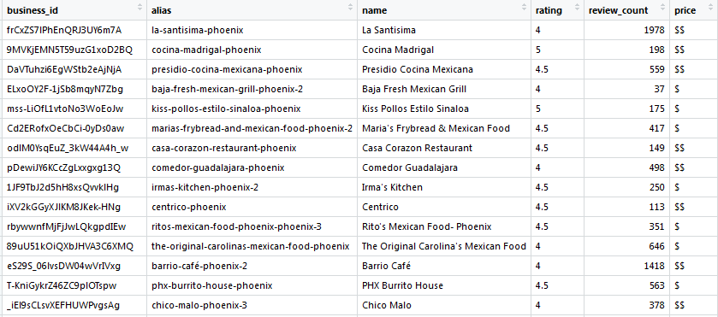
Gathering Data & Pre-Processing: Yelp API
Free Yelp Fusion API that interface with Yelp website in R
Limitations:
Only returns max of 50 rows per query
There’s a character limit that truncates text reviews
You can only extract up to 3 reviews for a specific restaurant.
4. Twitter API: Attempted to extract tweets for a specific restaurant from Twitter API
Successes: Able to access tweets for a chosen restaurant through R script.
Limitations: Only able to access tweets from past 6-9 days

Slide 5
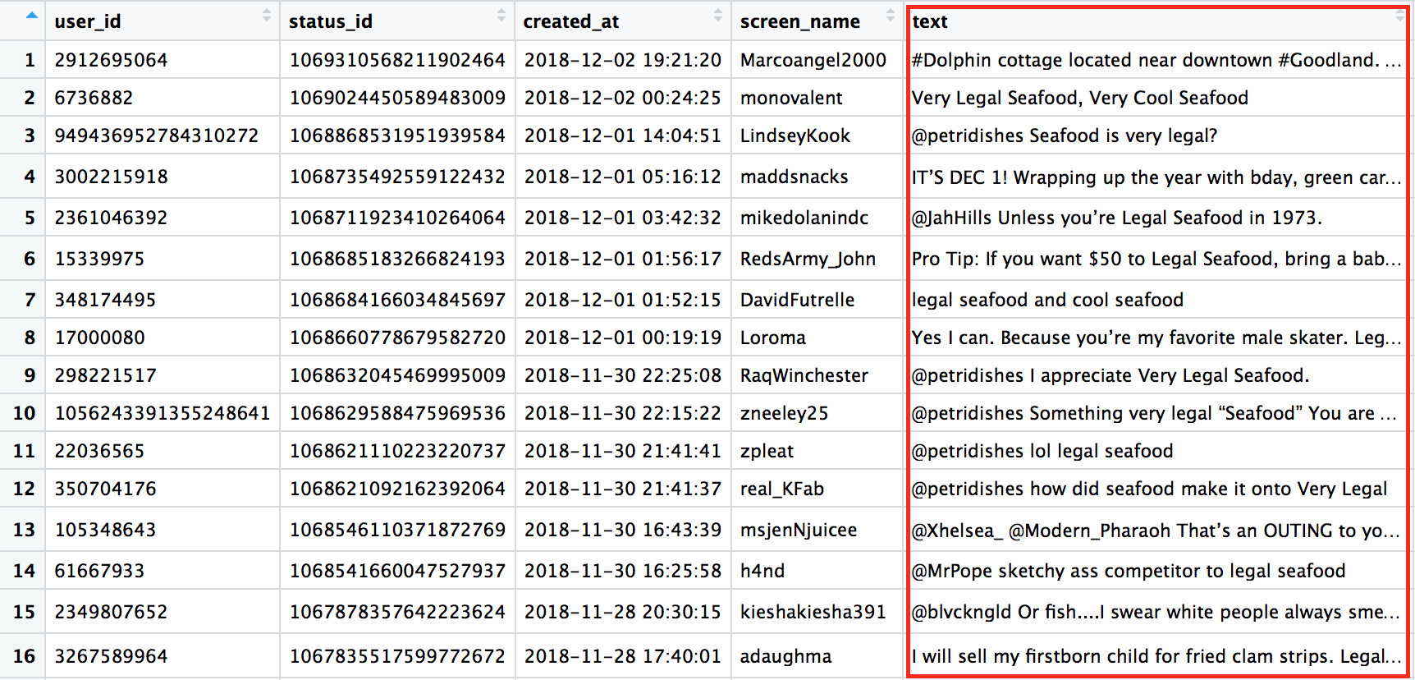
Gathering Data & Pre-Processing: Twitter API
Free Twitter API that calls most recent tweets that mention key terms
Limitations:
Only retrieves tweets from the last 6-9 days.
Can only request 18,000 tweets in one call.
4. Twitter API: Attempted to extract tweets for a specific restaurant from Twitter API
Successes: Able to access tweets for a chosen restaurant through R script.
Limitations: Only able to access tweets from past 6-9 days

Slide 6
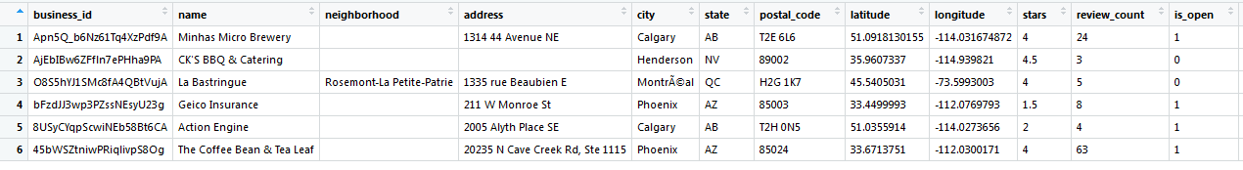
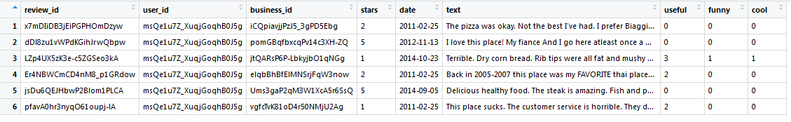
Gathering Data & Pre-Processing: Yelp Dataset
Free public dataset that contains 6M rows of reviews for 200K businesses
Was the primary source for subsequent text and sentiment analysis
Due to processing restraints, could only read the first 2M rows

Slide 7
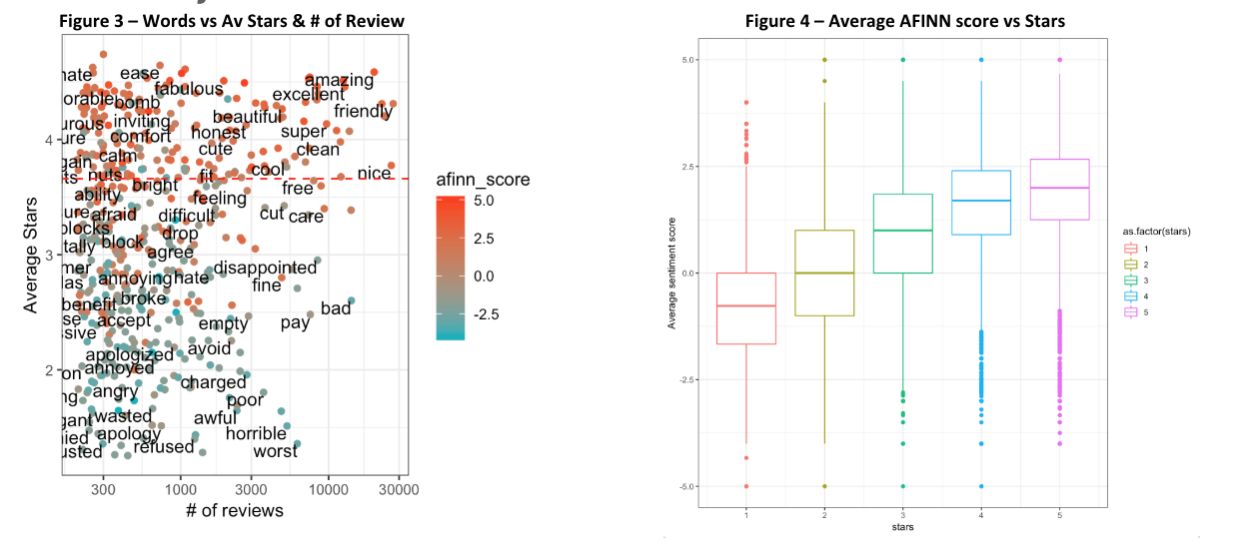
Text Mining - Use Case #1
Sentiment Analysis of restaurant reviews

Slide 8
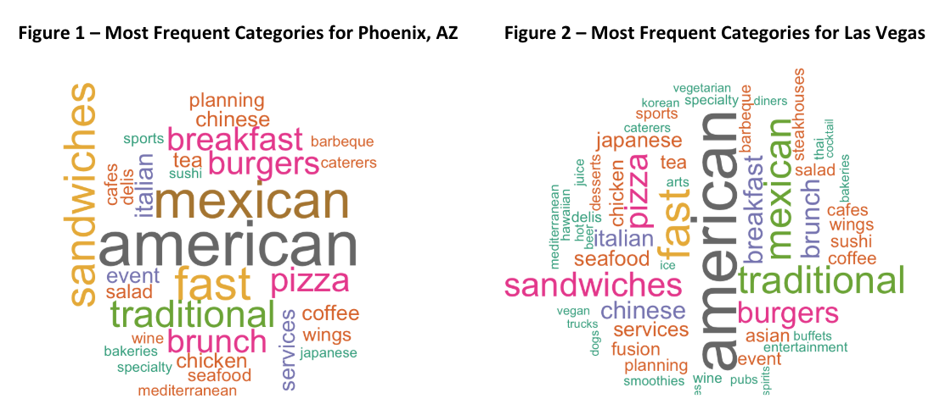
Text Mining - Use Case #2
When comparing Phoenix, AZ and Las Vegas, NV, what type of categories are most frequent? Are there any similarities between the two cities?

Slide 9
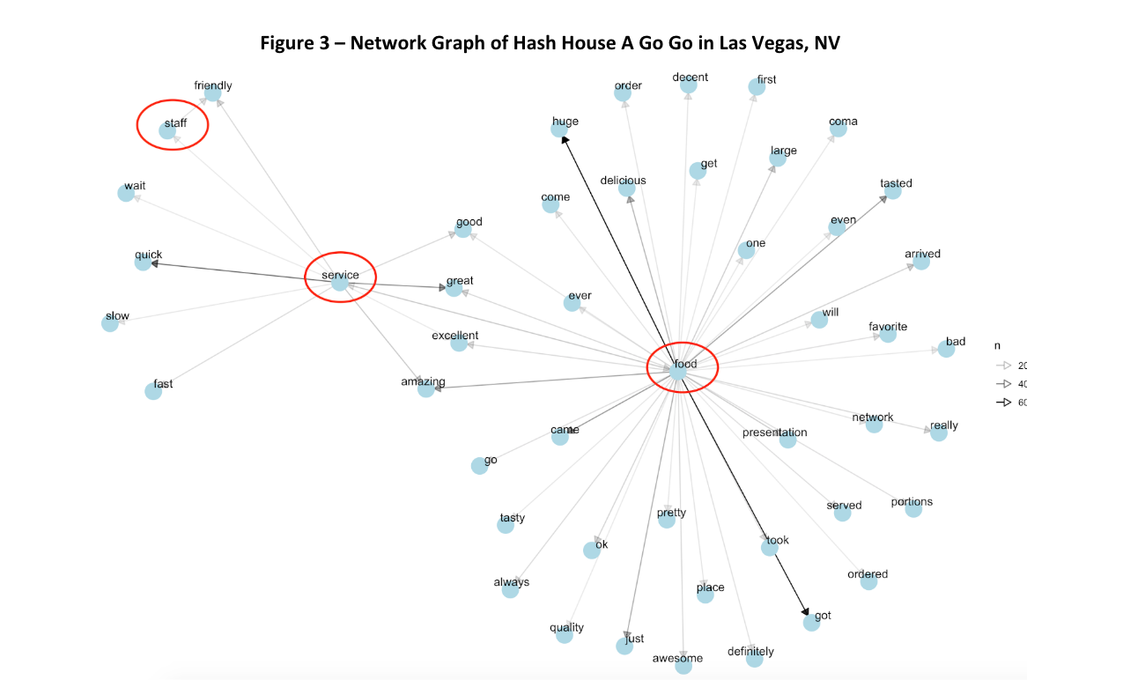
Text Mining - Use Case #3
Sentiment Analysis for the two top reviewed restaurants in Las Vegas: Which restaurant is rated higher for food, staff, service and atmosphere?
Restaurants:
Hash House A Go Go
Mon Ami Gabi

Slide 10
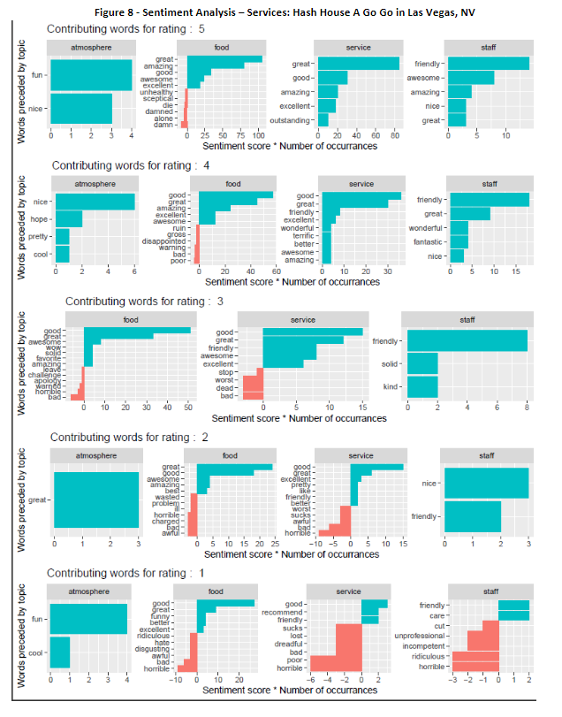
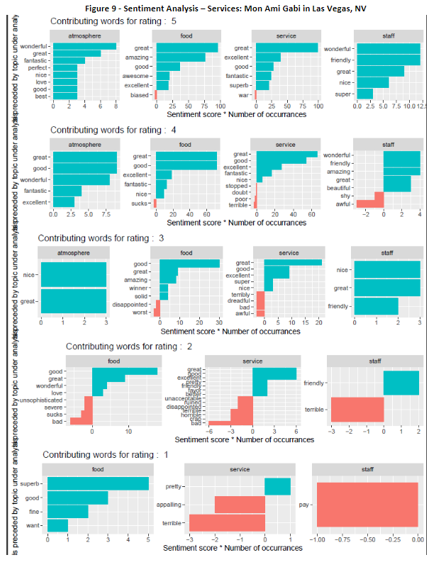
Text Mining - Use Case #3

Slide 11
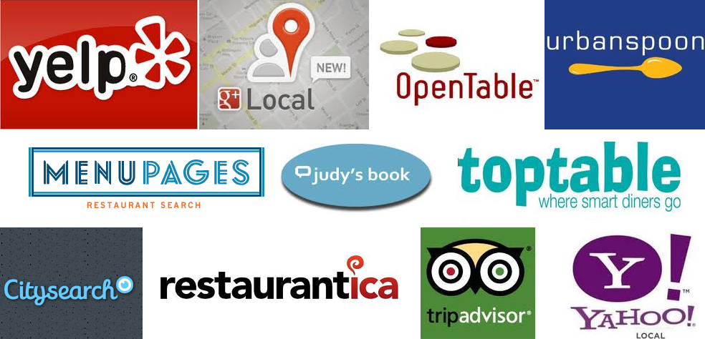
Conclusion & Beyond
Though social media mining and web scraping had technical limitations, we were able to uncover some interesting sentiment analysis findings from the Yelp dataset.
Sentiment of review text generally aligned with star ratings, but there were minor discrepancies observed when stratifying by different restaurant factors.
Next steps would be to try and capture emotions of reviews through sentiment analysis. Also, in order to access a higher quality data, it would be worth investigating options to purchase datasets and API subscriptions from review sites.

